Slide 1

Big data telecom
use cases

Slide 2
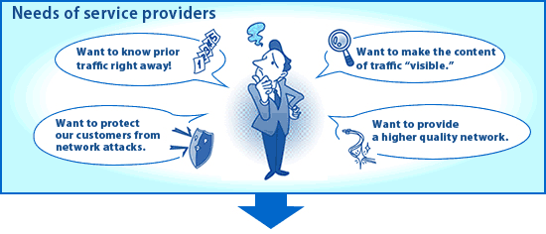
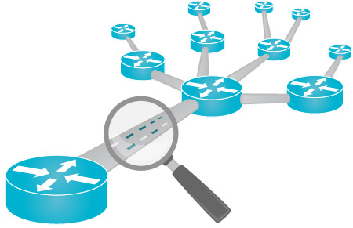
Network Management/Optimizations
Pain Areas:
Unexpected spike of Network traffic can cause service outages to the customers
Inability to have real-time analysis of routing algorithms used and tweak them based on changes in supplier rates and customer behavior
3 Long time to generate reports and analyze them from multiple perspectives
Benefits:
1. Service providers can optimize the quality of service (QoS) and routing by being able to analyze network traffic in real time. This enables them to respond to fluctuations in traffic and reallocate bandwidth as needed.
2. Allocate unused Bandwidth in Real-time

Slide 3

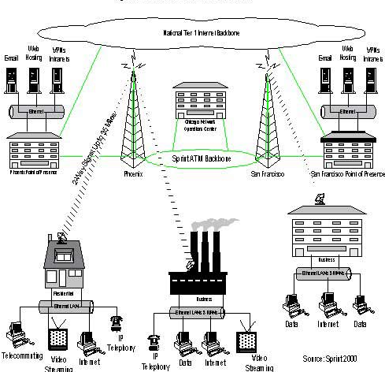


Network Inventory Alignment
Pain Areas :
1. Inadequate usage of available ports on the network, thus network capacity going surplus
2. Discrepancy between Supplier/Maintainer invoice for CPE thus Operator under billing/over billing/not billing to the customer
3. Improper utilization of Access, mismatch between Access Supplier charges and Operator billing to customer
4. Penalty paid to the customer due to SLA breach
5. Customer dissatisfaction
Not in Synch
Network Inventory
Not in Synch
Network System
NW provisioning

Slide 4


Call Drop Analysis
Call Drops directly impact the primary offering of a Telco i.e. Voice. It also has a major influence on the perception of the customer on the Quality of Service offered by a Telco. Also stringent regulatory norms in every country make it all the more important for Telcos to focus on the same for all the areas they cater to. It is thus convenient if a Telco could have a single view of the call drops on his networks around the globe and be alerted in quick time, in case of any breach in expected call quality measures.
Pain Areas :
1. It is difficult to analyze the reason for call drops since the volume of voice data generated is huge and the reason for call drops are varied – network failures, customer handset compatibility issues, handover issues, credit limit, outstanding balance, etc.
2. Dissatisfied customers may not always report on frequent call drops but would have a greater propensity to churn out in search of better services/coverage
Call dropping

Slide 5
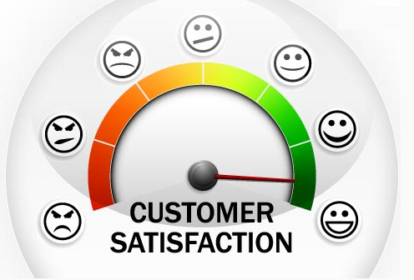
Recommendations to Customers
CSPs can make more accurate and relevant recommendations to customers in real time by analyzing customer call logs, usage and customer satisfaction data combined with social media data to understand customer preferences and behavior. These recommendations can include cross-selling new services, matching pricing plans, or making targeted offers for sports or music enthusiasts

